Slide 1
Fast Distributed Beamforming without Receiver Feedback
Kushal Chakrabarti, Amrit S. Bedi, Fikadu T. Dagefu, Jeffrey N. Twigg, and Nikhil Chopra
University of Maryland College Park
U.S. Army Research Laboratory, Adelphi
2022 Asilomar Conference on Signals, Systems, and Computers
October 30th - November 2nd , 2022
This work has been partially funded by ARL Grant No. W911NF2120076.

Slide 2
Distributed Beamforming
Wireless Communication in Presence of Near-peer Adversaries
Increasing Operational Tempo of Future Battles (Requires Autonomy)
Reliability in Complex Environments (e.g., Dense Urban, Indoors, Forests)
Objective
Fast Distributed Beamforming without Receiver Feedback

Slide 3
Distributed Beamforming
Wireless Communication in Presence of Near-peer Adversaries
Increasing Operational Tempo of Future Battles (Requires Autonomy)
Reliability in Complex Environments (e.g., Dense Urban, Indoors, Forests)
Objective
Inspiration: Phased Antenna Array
Creates coherent signal using multiple antennas
Directional, Controlled Pattern
Covert Communications
Targeted Jamming
Radar
Electronically steerable
Gain is N^2
5 Element Array @2W
= 1 50W Tx
Coherent
Phase Front
Phase Controller
Fast Distributed Beamforming without Receiver Feedback

Slide 4
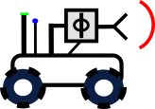
Distributed Beamforming
Wireless Communication in Presence of Near-peer Adversaries
Increasing Operational Tempo of Future Battles (Requires Autonomy)
Reliability in Complex Environments (e.g., Dense Urban, Indoors, Forests)
Objective
Inspiration: Phased Antenna Array
Creates coherent signal using multiple antennas
Directional, Controlled Pattern
Covert Communications
Targeted Jamming
Radar
Electronically steerable
Gain is N^2
5 Element Array @2W
= 1 50W Tx
Coherent
Phase Front
Distributed Robotic Beamforming
Distributed, resilient to single-agent failure
Agile, composed of evolving robot swarm
Adapt to environment and near-peer adversary
Distributed
Across
Robots
Phase Controller
Fast Distributed Beamforming without Receiver Feedback

Slide 5
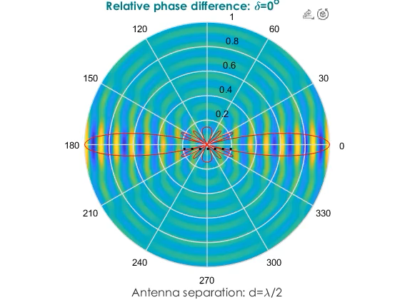
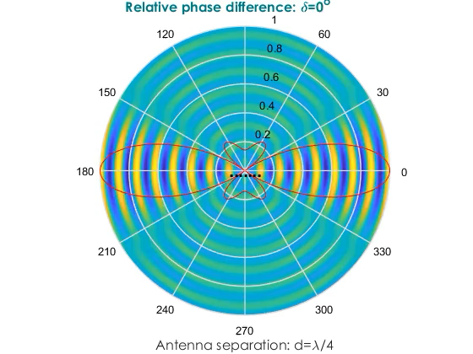
Controlling Covert Directional Communication
How do we autonomously control signal strength (signature management) in different desired directions simultaneously?
Fast Distributed Beamforming without Receiver Feedback

Slide 6
Performance Measures of a Beamforming Technique
open-loop or closed-loop
feedback required?
unlikely to get feedback from null receivers
guarantee convergence
algorithm converges? (future work)
exact solution exists?
how many transmitting agents? (ongoing work)
rate of convergence
smaller number of iterations
characterize number of iterations (future work)
robustness
unknown channel parameters
receiver locations not precise (future work)
directivity
spread of combined signal in other directions? (future work)
node placement and node selection
optimize position and the number of active agents (future work)
Fast Distributed Beamforming without Receiver Feedback

Slide 7
Existing Works
[1] D Richard Brown, Upamanyu Madhow, Patrick Bidigare, and Soura Dasgupta. Receiver-coordinated distributed transmit nullforming with channel state uncertainty. In 2012 46th Annual Conference on Information Sciences and Systems (CISS), pages 1–6. IEEE, 2012.
[2] Yongsheng Fan, Yuanping Zhou, Donglin He, and Wenlong Xia. Fast transmit beamforming with distributed antennas. IEEE Antennas and Wireless Propagation Letters, 16:121–124, 2016.
[3] Sairam Goguri, Ben Peiffer, Raghu Mudumbai, and Soura Dasgupta. A class of scalable feedback algorithms for beam and null-forming from distributed arrays. In 2016 50th Asilomar Conference on Signals, Systems and Computers, pages 1447–1451. IEEE, 2016.
[4] Justin S Kong, Fikadu T Dagefu, and Brian M Sadler. Distributed adaptive beamforming and nullforming for secure wireless communications, March 31 2022. US Patent App. 17/205,355.
[5] Amy Kumar, Raghuraman Mudumbai, Soura Dasgupta, Upamanyu Madhow, and D Richard Brown. Distributed MIMO multicast with protected receivers: A scalable algorithm for joint beamforming and nullforming. IEEE Transactions on Wireless Communications, 16(1):512–525, 2016.
[6] Jemin George, Anjaly Parayil, Cemal Tugrul Yilmaz, Bethany L Allik, He Bai, and Aranya Chakrabortty. Multi-agent coordination for distributed transmit beamforming. In 2020 American Control Conference (ACC), pages 144–149. IEEE, 2020.
[7] Jemin George, Cemal Tugrul Yilmaz, Anjaly Parayil, and Aranya Chakrabortty. A model-free approach to distributed transmit beamforming. In ICASSP 2020-2020 IEEE International Conference on Acoustics, Speech and Signal Processing (ICASSP), pages 5170–5174. IEEE, 2020. [8] Anjaly Parayil, Amrit Singh Bedi, and Alec Koppel. Joint position and beamforming control via alternating nonlinear least-squares with a hierarchical gamma prior. In 2021 American Control Conference (ACC), pages 3513–3518. IEEE, 2021. [9] Tzanis Anevlavis, Jonathan Bunton, Anjaly Parayil, Jemin George, and Paulo Tabuada. To beam or not to beam? beamforming with submodularity-inspired group sparsity. In 2020 59th IEEE Conference on Decision and Control (CDC), pages 390–395. IEEE, 2020. [10] Arjun Muralidharan and Yasamin Mostofi. Energy optimal distributed beamforming using unmanned vehicles. IEEE Transactions on Control of Network Systems, 5(4):1529–1540, 2017.
[11] Samer Hanna, Enes Krijestorac, and Danijela Cabric. Destination-feedback free distributed transmit beamforming using guided directionality. arXiv preprint arXiv:2108.01837, 2021
 | Prior Works
[1]-[4] | objective: maximizing gain or steering nulls at specific locations
[5]-[7] | utilize receiver feedbacks
[8], [9] | sparse beamforming, mobile agents
[7], [10] | channel model-free [7], probabilistic channel prediction and path planning for minimizing power [10]
[11] | receiver feedback-free
Fast Distributed Beamforming without Receiver Feedback

Slide 8
Comparison with Existing Works
Prior Works | Our Work
objective: maximizing gain or steering nulls at specific locations | objective: beampattern matching advantages: precise control over power at multiple locations, inherent beamforming and nullforming in constructive manner, can include additional constraints (limited transmit power, derivative constraints)
utilize receiver feedbacks | does not require receiver feedbacks
sparse beamforming, mobile agents | fixed number of agents, stationary agents
channel model-free, probabilistic channel prediction for minimizing power | feedback-free, objective: beampattern matching
receiver feedback-free | does not assume line of sight (LOS) channels
Fast Distributed Beamforming without Receiver Feedback

Slide 9
Our Contributions
proposed a novel algorithm: Iteratively Pre-conditioned Gradient-descent for Distributed Beamforming (IPG-DB)
significantly faster than the gradient-descent (GD) based methods
does not rely on receiver feedbacks
does not assume channel fading parameters: significantly robust to channel noise
replace slower GD with faster IPG-DB for position, sparsity, and excitation in [1]
[1] Anjaly Parayil, Amrit Singh Bedi, and Alec Koppel. Joint position and beamforming control via alternating nonlinear least-squares with a hierarchical gamma prior. In 2021 American Control Conference (ACC), pages 3513–3518. IEEE, 2021.
Fast Distributed Beamforming without Receiver Feedback

Slide 10





Proposed Setting of Beamforming Agents
server-agent based setting
agents communicate with server
no peer-to-peer communication
what is a server?
can be an auxiliary node, located close to the agents
can exchange information with the agents
can process information
need not know the beamforming problem
server
Tx
$$a_{1},α_{1}$$
$$a_{2},α_{2}$$
$$a_{n},α_{n}$$
Tx
Target Rx
Null Rx/ Adversary
Fast Distributed Beamforming without Receiver Feedback

Slide 11
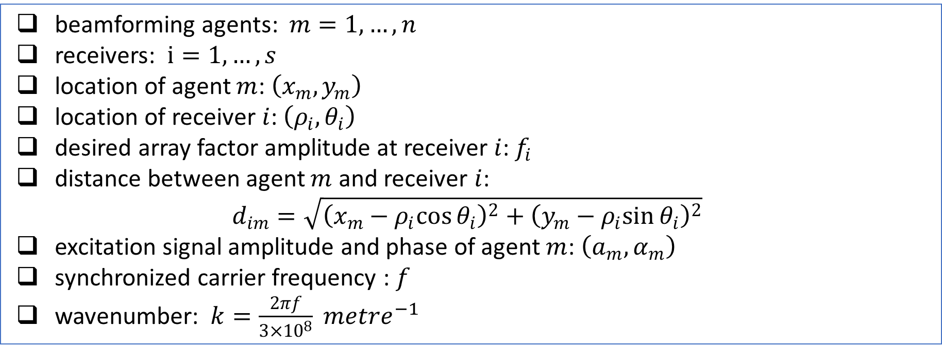
Problem Formulation: Notation
beamforming agents: $m=1,…,n$
receivers: $i=1,…,s$
location of agent $m$: $\left(x_{m},y_{m}\right)$
location of receiver $i$: $\left(ρ_{i},θ_{i}\right)$
desired array factor amplitude at receiver $i$: $f_{i}$
distance between agent $m$ and receiver $i$:
$$d_{im}=\sqrt{{\left(x_{m}−ρ_{i}cos{θ_{i}}\right)}^{2}+{\left(y_{m}−ρ_{i}sin{θ_{i}}\right)}^{2}}$$
excitation signal amplitude and phase of agent $m$: $\left(a_{m},α_{m}\right)$
synchronized carrier frequency : $f$
wavenumber: $k=\frac{2πf}{3×{10}^{8}} {metre}^{−1}$
Fast Distributed Beamforming without Receiver Feedback

Slide 12
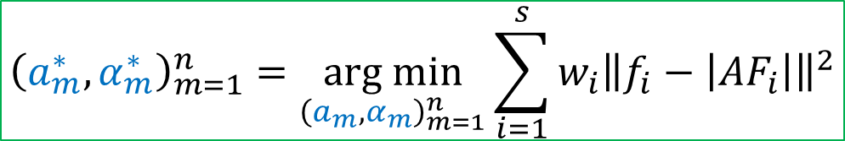
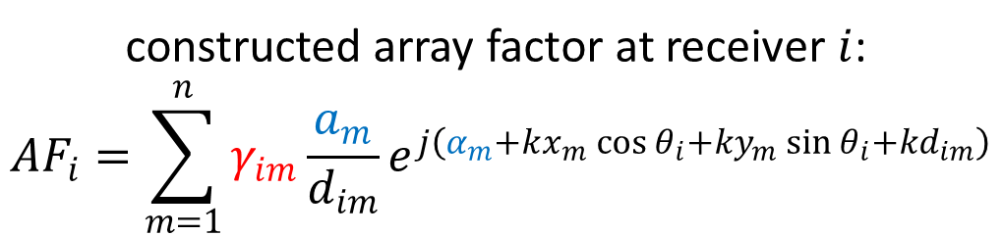
Problem Formulation: Optimization
constructed array factor at receiver $i$:
$${AF}_{i}=\sum_{m=1}^{n}{γ_{im}\frac{a_{m}}{d_{im}}e^{j\left(α_{m}+kx_{m}\cos{θ_{i}}+ky_{m}\sin{θ_{i}+kd_{im}}\right)}}$$
unknown multipath fading
control parameters
$${\left(a_{m}^{∗},α_{m}^{∗}\right)}_{m=1}^{n}=\underset{{\left(a_{m},α_{m}\right)}_{m=1}^{n}}{arg min}{\sum_{i=1}^{s}{w_{i}{\left\|f_{i}−\left|{AF}_{i}\right|\right\|}^{2}}}$$
[1] Jemin George, Anjaly Parayil, Cemal Tugrul Yilmaz, Bethany L Allik, He Bai, and Aranya Chakrabortty. Multi-agent coordination for distributed transmit beamforming. In 2020 American Control Conference (ACC), pages 144–149. IEEE, 2020.
Fast Distributed Beamforming without Receiver Feedback

Slide 13
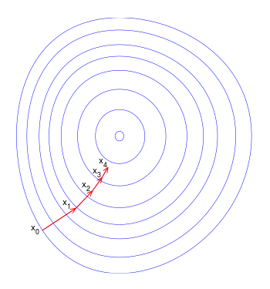
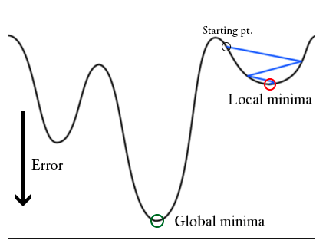

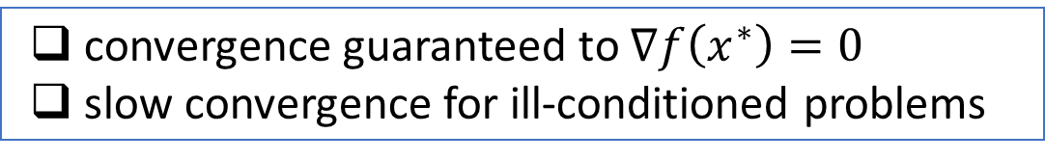
Intuition behind Proposed Algorithm IPG-DB
$$\min_{x∈ℝ^{d}}{f(x)}$$
Gradient-Descent:
$$x\left(t+1\right)=x\left(t\right)−δ∇f\left(x\left(t\right)\right), t=0,1,…$$
convergence guaranteed to $∇f\left(x^{∗}\right)=0$
slow convergence for ill-conditioned problems
Fast Distributed Beamforming without Receiver Feedback

Slide 14


Intuition behind Proposed Algorithm IPG-DB
$$\min_{x∈ℝ^{d}}{f(x)}$$
Gradient-Descent:
$$x\left(t+1\right)=x\left(t\right)−δ∇f\left(x\left(t\right)\right), t=0,1,…$$
convergence guaranteed to $∇f\left(x^{∗}\right)=0$
slow convergence for ill-conditioned problems
Newton’s Method:
$$x\left(t+1\right)=x\left(t\right)−{∇^{2}f(x\left(t\right))}^{−1}∇f\left(x\left(t\right)\right), t=0,1,…$$
fast quadratic convergence
vulnerable to channel noise
Fast Distributed Beamforming without Receiver Feedback

Slide 15
Intuition behind Proposed Algorithm IPG-DB
$$\min_{x∈ℝ^{d}}{f(x)}$$
Gradient-Descent:
$$x\left(t+1\right)=x\left(t\right)−δ∇f\left(x\left(t\right)\right), t=0,1,…$$
convergence guaranteed to $∇f\left(x^{∗}\right)=0$
slow convergence for ill-conditioned problems
Newton’s Method:
$$x\left(t+1\right)=x\left(t\right)−{∇^{2}f(x\left(t\right))}^{−1}∇f\left(x\left(t\right)\right), t=0,1,…$$
fast quadratic convergence
vulnerable to channel noise
stabilization parameter for non-convex costs
Iteratively Pre-conditioned Gradient-Descent (IPG) [1]:
$$K\left(t+1\right)=K\left(t\right)−ε(t)(∇^{2}f\left(x\left(t\right)\right)K\left(t\right)+βK\left(t\right)−I), t=0,1,…$$
$$x\left(t+1\right)=x\left(t\right)−δK(t)∇f\left(x\left(t\right)\right), t=0,1,…$$
$$K^{∗} s.t. ∇^{2}f\left(x^{∗}\right)K^{∗}+βK^{∗}=I ≡K^{∗}={(∇^{2}f\left(x^{∗}\right)+βI)}^{−1}$$
[1] Kushal Chakrabarti, Nirupam Gupta, and Nikhil Chopra. On accelerating distributed convex optimization. arXiv preprint arXiV:2108.08670, 2021.
Fast Distributed Beamforming without Receiver Feedback

Slide 16

From IPG to IPG-DB
$$x\left(t\right)={\left(a_{1}\left(t\right),{…,a}_{n}\left(t\right),α_{1}\left(t\right),…α_{n}\left(t\right)\right)}^{T}$$
$$x\left(t+1\right)=x\left(t\right)−δK(t)∇f\left(x\left(t\right)\right), t=0,1,…$$
$k_{j}\left(t\right):j$-th row of $K\left(t\right)$
$$a_{m}\left(t+1\right)=a_{m}\left(t\right)−δk_{m}\left(t\right)∇f\left(x\left(t\right)\right), m=1,…,n$$
depends on $x\left(t\right)={\left(a_{1}\left(t\right),{…,a}_{n}\left(t\right),α_{1}\left(t\right),…α_{n}\left(t\right)\right)}^{T}$
How to distribute?
Fast Distributed Beamforming without Receiver Feedback

Slide 17

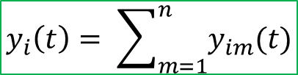
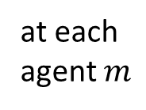
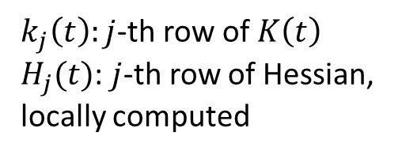




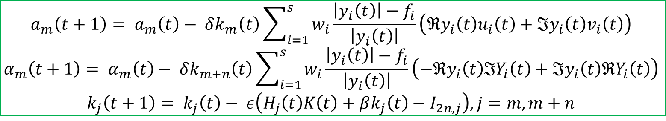
Description of IPG-DB Algorithm
agent $m$: $\left(a_{m}(t),α_{m}(t)\right)$, server: $K\left(t\right) ∈ ℝ^{2n×2n}$
server broadcasts to each agent: $ε, β, δ, K(0)$
For each iteration $t≥0$:
$$ζ_{im}=kx_{m}\cos{θ_{i}}+ky_{m}\sin{θ_{i}+kd_{im}}$$
$u_{im}(t)=\frac{1}{d_{im}}\cos\left(α_{m}\left(t\right)+ζ_{im}\right)$, $v_{im}\left(t\right)=\frac{1}{d_{im}}\sin\left(α_{m}\left(t\right)+ζ_{im}\right)$, $y_{im}\left(t\right)=a_{m}(t)\left(u_{im}\left(t\right)+jv_{im}(t)\right)$
at each agent $m$
$\left\{u_{im}\left(t\right),v_{im}\left(t\right),y_{im}\left(t\right), i=1,…,s\right\}$, $k_{m}\left(t\right),k_{m+n}\left(t\right)$
$k_{j}\left(t\right):j$-th row of $K\left(t\right)$
$H_{j}(t)$: $j$-th row of Hessian, locally computed
agent $m$ to server
$$y_{i}\left(t\right)= \sum_{m=1}^{n}{y_{im}(t)}$$
at server
$u_{i}\left(t\right)={\left[u_{i1}\left(t\right),…,u_{in}\left(t\right)\right]}^{T}$, $v_{i}\left(t\right)={\left[v_{i1}\left(t\right),…,v_{in}\left(t\right)\right]}^{T}$, $Y_{i}\left(t\right)={\left[y_{i1}\left(t\right),…,y_{in}\left(t\right)\right]}^{T}$
$\left\{y_{i}\left(t\right), i=1,…,s\right\}$,$\left\{u_{i}\left(t\right),v_{i}\left(t\right),Y_{i}\left(t\right), i=1,…,s\right\}$, $K\left(t\right)$
server to each agent $m$
$$a_{m}\left(t+1\right)= a_{m}\left(t\right)− δk_{m}\left(t\right)\sum_{i=1}^{s}{w_{i}\frac{\left|y_{i}\left(t\right)\right|−f_{i}}{\left|y_{i}\left(t\right)\right|}}\left(ℜy_{i}\left(t\right)u_{i}\left(t\right)+ℑy_{i}\left(t\right)v_{i}\left(t\right)\right)$$
$$α_{m}\left(t+1\right)= α_{m}\left(t\right)− δk_{m+n}\left(t\right)\sum_{i=1}^{s}{w_{i}\frac{\left|y_{i}\left(t\right)\right|−f_{i}}{\left|y_{i}\left(t\right)\right|}}\left(−ℜy_{i}\left(t\right)ℑY_{i}\left(t\right)+ℑy_{i}\left(t\right)ℜY_{i}\left(t\right)\right)$$
$$k_{j}\left(t+1\right)= k_{j}\left(t\right)− ε\left(H_{j}\left(t\right)K\left(t\right)+βk_{j}\left(t\right)−I_{2n,j}\right), j=m,m+n$$
at each agent $m$
Fast Distributed Beamforming without Receiver Feedback

Slide 18
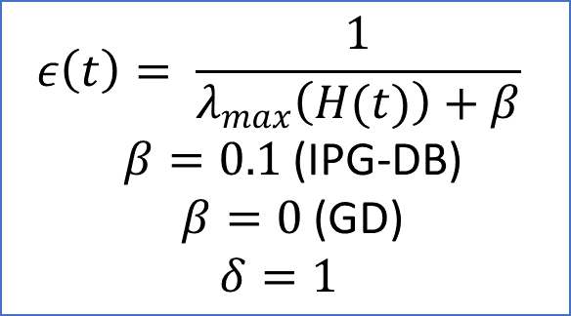
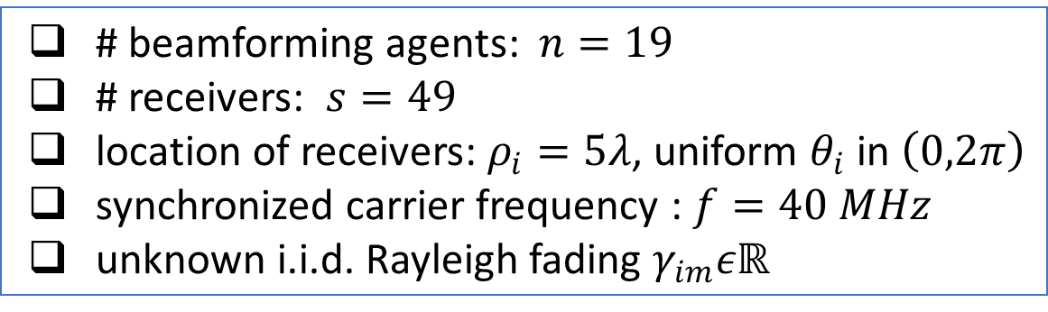
Empirical Results: Synthetic Data
problem settings
algorithm parameters
# beamforming agents: $n=19$
# receivers: $s=49$
location of receivers: $ρ_{i}=5λ$, uniform $θ_{i}$ in $\left(0,2π\right)$
synchronized carrier frequency : $f=40 MHz$
unknown i.i.d. Rayleigh fading $γ_{im}εℝ$
$$ε\left(t\right)= \frac{1}{λ_{max}\left(H(t)\right)+β}$$
$β=0.1$ (IPG-DB)
$β=0$ (GD)
$$δ=1$$
Fast Distributed Beamforming without Receiver Feedback

Slide 19
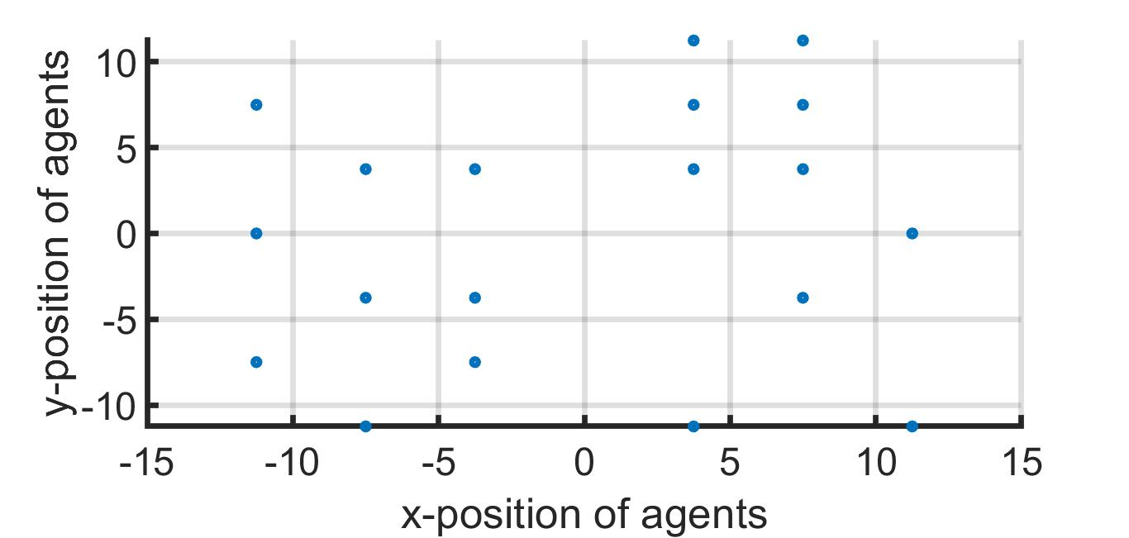
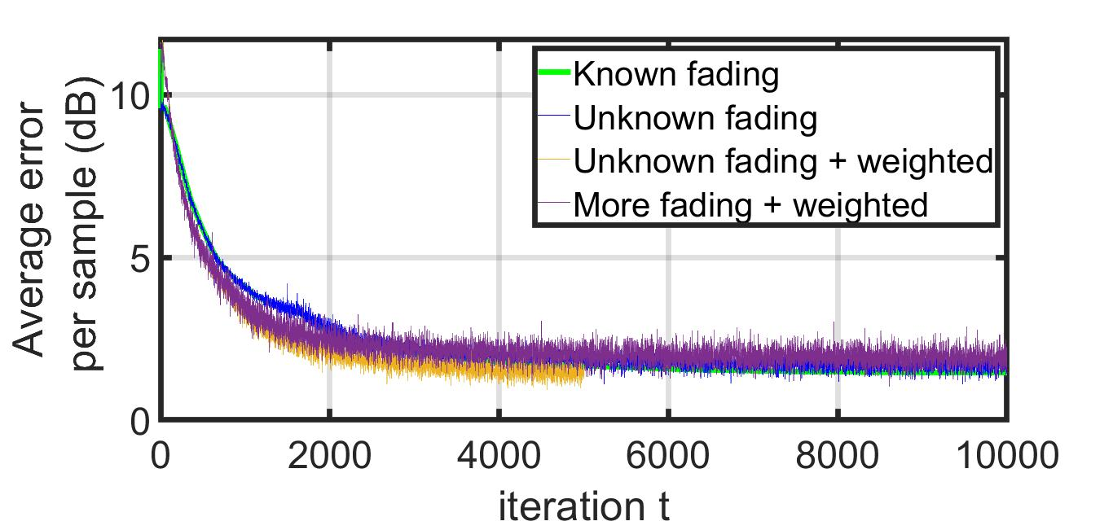
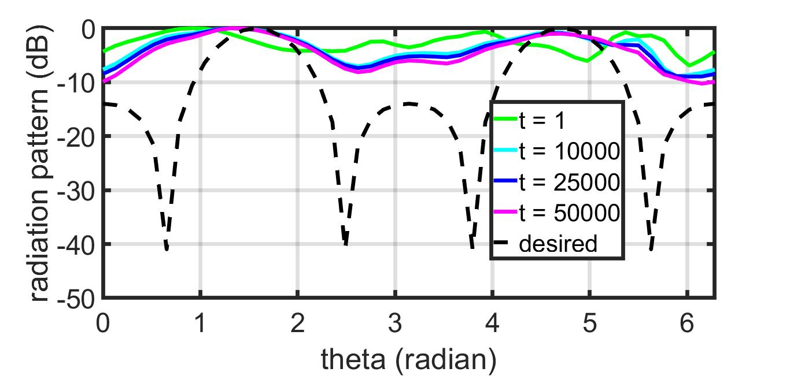
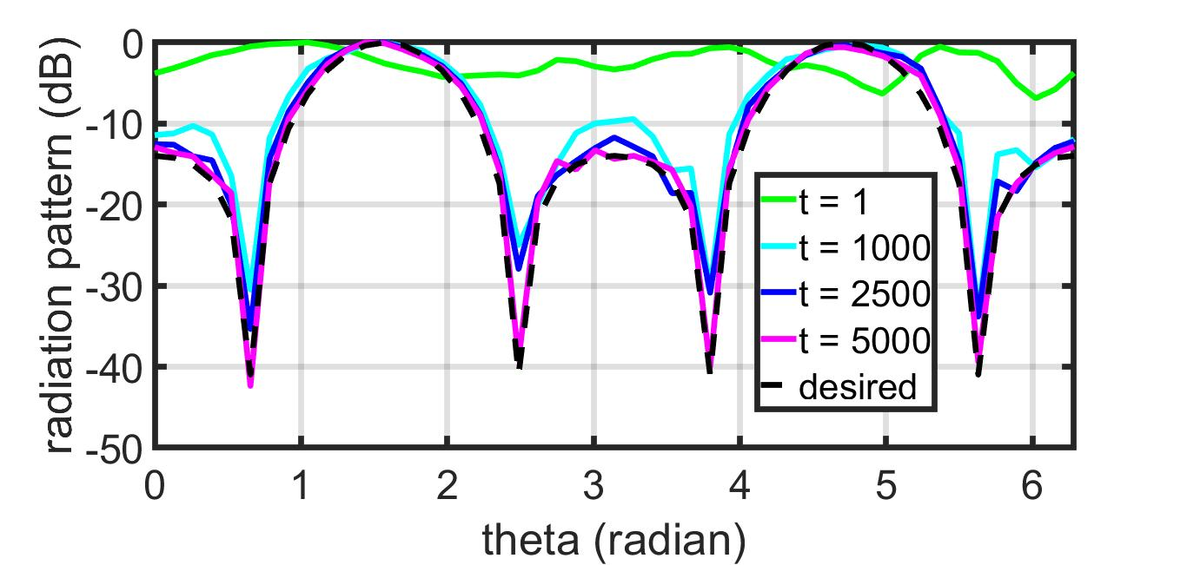
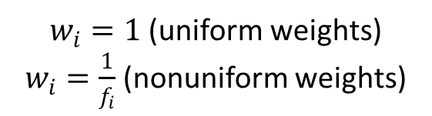
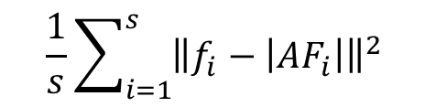
Empirical Results: Synthetic Data
$w_{i}=1$ (uniform weights)
$w_{i}=\frac{1}{f_{i}}$ (nonuniform weights)
$$\frac{1}{s}\sum_{i=1}^{s}{{\left\|f_{i}−\left|{AF}_{i}\right|\right\|}^{2}}$$
GD
IPG-DB
Fast Distributed Beamforming without Receiver Feedback

Slide 20
Summary
Autonomous multi-robots collaboratively form an antenna array to transmit a high-power directed signal while steering nulls through precise control of interference.
Proposed self-configuring IPG-DB algorithm controls Tx phase+amplitude for covert directional communication without Rx feedback.
IPG-DB is significantly robust to the condition number of the problem and noisy channels, and hence, can reach a satisfactory neighborhood of the desired pattern in a fewer number of iterations.
Acceleration due to the proposed IPG-DB algorithm enables rapid establishment of communication links in contested environment.
Fast Distributed Beamforming without Receiver Feedback

